Slide 1


SEISMIC EVENT DETECTOR
Team: Nakshatra
Team Members:
1) Durvesh Baharwal (Lead)
2) Om Koli
3) Tanuj Kaswa

Slide 2
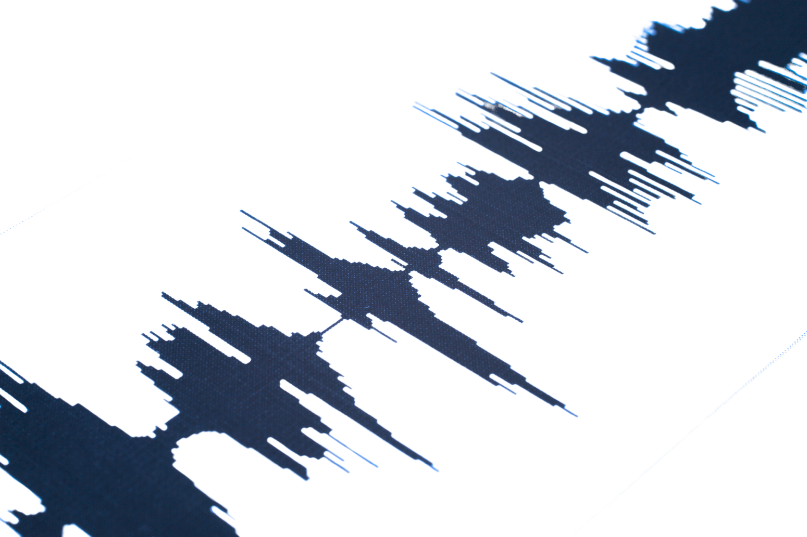
PROBLEM STATEMENT:
The challenge is to identify seismic events amidst noise.
What we plan to do:
To build an algorithm to detect the start of seismic events, enabling the lander to send only useful data, saving power and bandwidth.

Slide 3
OBJECTIVES AND APPROACH
Objectives:
Approach:
1
Detect seismic events within noise
Manual Detection
2
Minimize computational cost and power consumption
An API to interactively identify seismic events using time and threshold parameters.
3
Develop an efficient detection algorithm
Automated Detection
4
Optimize data for transmission back to Earth
Develop a Statistical algorithm to automatically detect seismic events in the noise.

Slide 4






CODE WORKFLOW
Code Workflow: DOT Seismic Detector
Detecting highest Point
Data Loading
Manual Least Square Fitting
Backtracking for Seismic Event Detection
Data Preprocessing
Moving Average Smoothing
Visualization

Slide 5
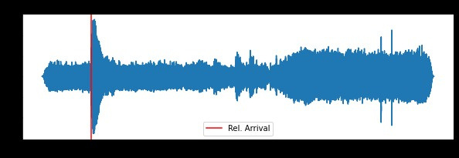
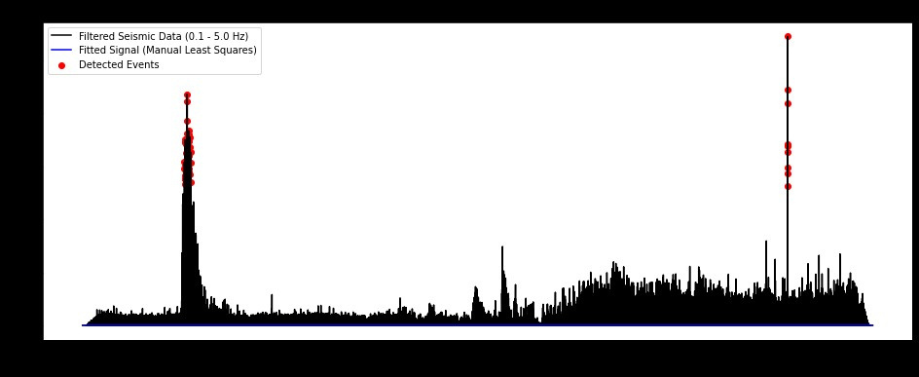
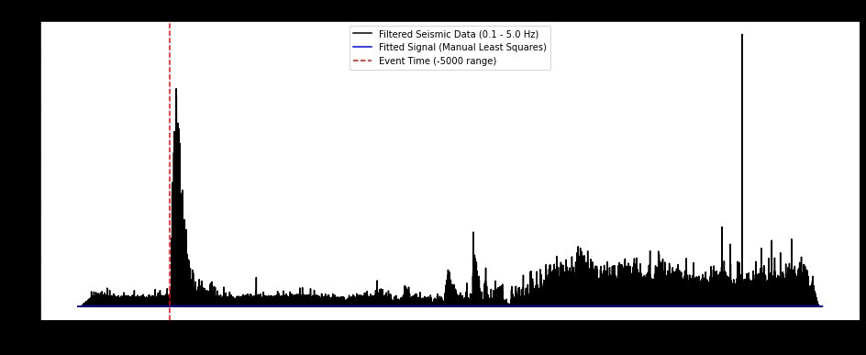
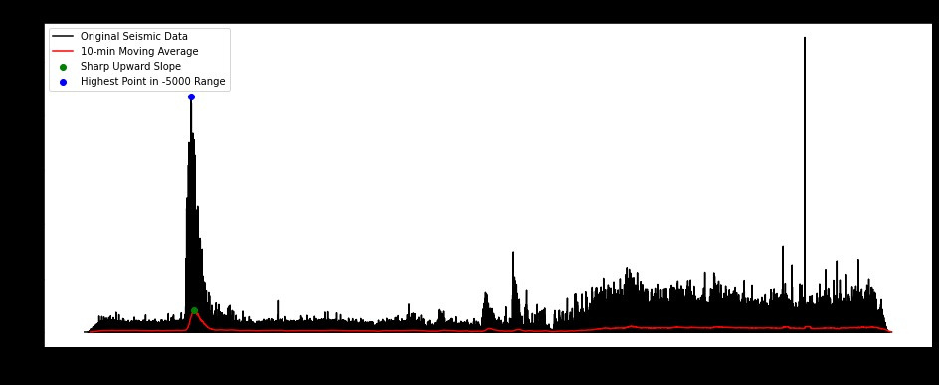
What we did?
Step 1
Detected Seismic Data Points
Step 2
Noisy Lunar Data
Start of Seismic Event Detected
Highest Point of Actual Seismic Event
Step 4
Step 3

Slide 6
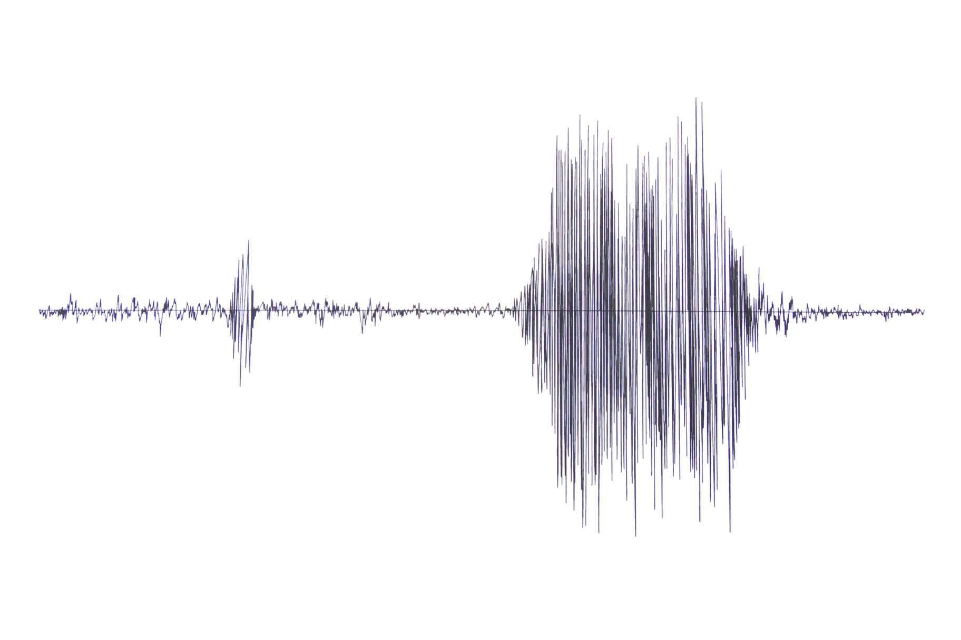
IMPACT
1
Reducing lander data transmission
2
Sending only valuable seismic data
3
Filtering noise for quality improvement
4
Monitoring quakes every 24 hours

Slide 7
CONCLUSION AND FUTURE WORK
Conclusion:
Our algorithm effectively detects seismic events with accuracy of 96% within noisy planetary data, reducing unnecessary transmissions. This conserves power and bandwidth, making future missions more efficient and enabling better scientific analysis.
Future work:
Accurately detect the end of seismic events.
Train a machine learning model for improved accuracy.

